Slide 1


Covid in a Flask
Siva Thangaraj
Roopa Reddy
Kushboo Shah
Victor Ime
Julie John

Slide 2
Covid App - Overview
The intend of Covid app is extraction, analysis and visualization of global realtime Covid data retrieved from European CDC.
Data visualization on how the crude oil prices and natural oil price have been affected with number of cases globally.
Analysis of forex rate since the beginning of global pandemic.

Slide 3
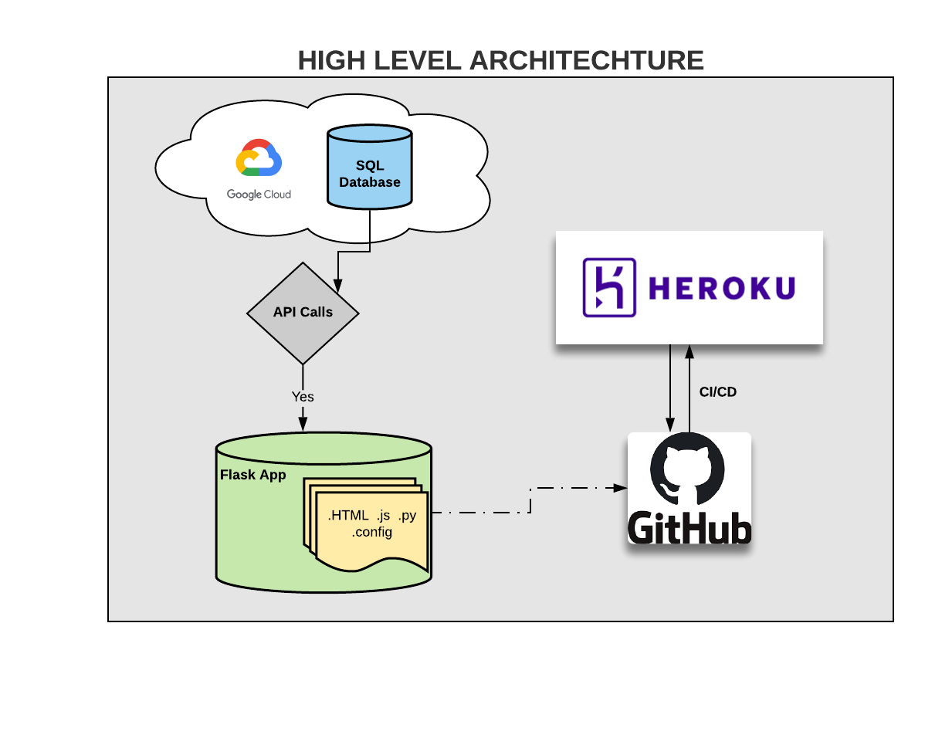
High Level Architecture

Slide 4
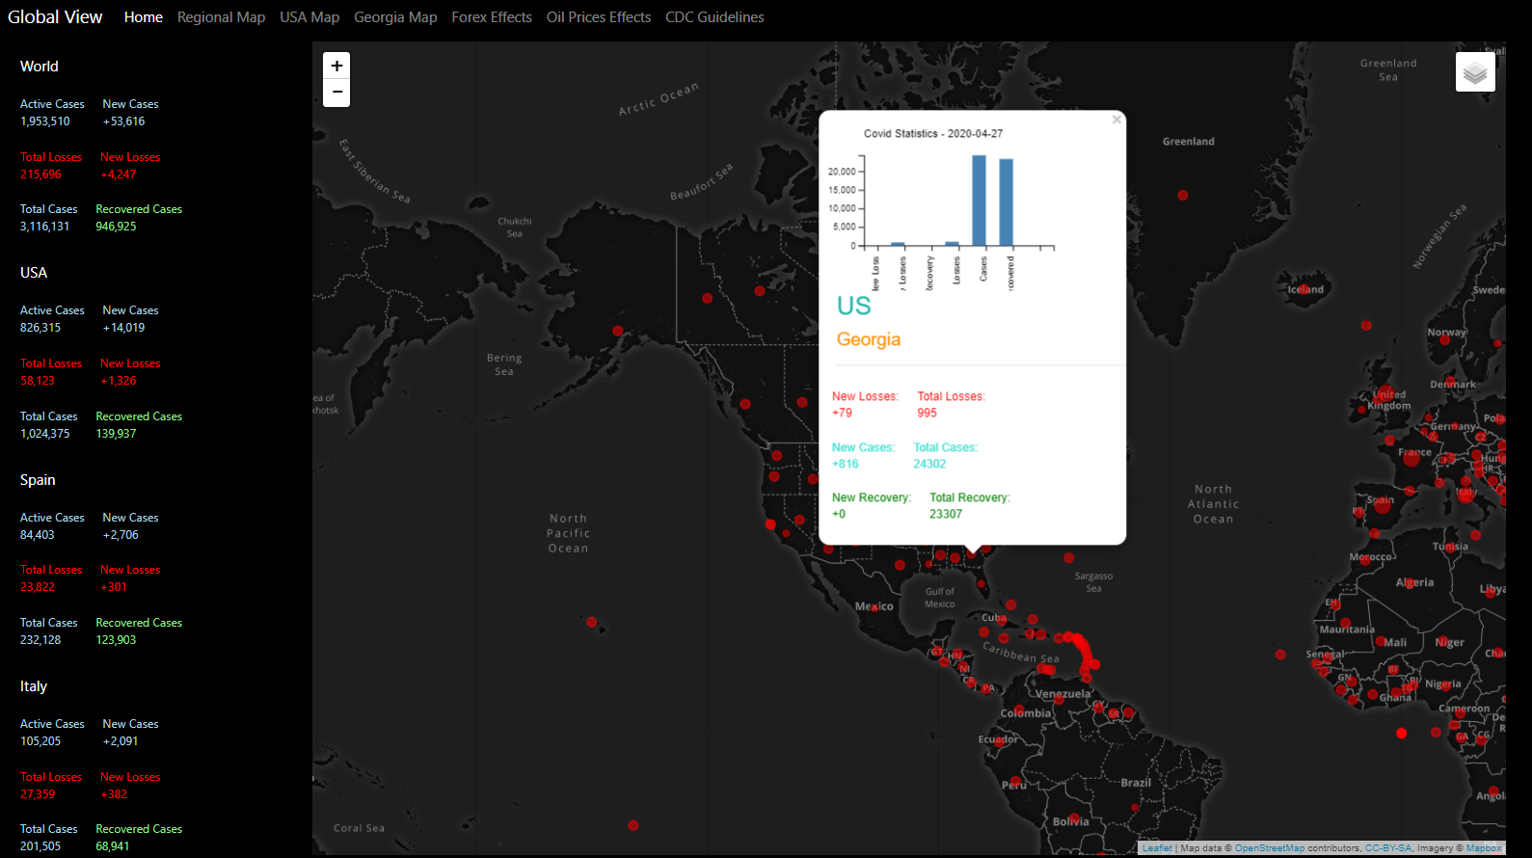
Covid App Demo

